Slide 1


Harmonizing with STEAM Standards
Harmonizing with STEAM Standards
Jeanne Lazzarini
jlazzarini@raft.net
Dianne Hurvitz
dianne@raft.net
Notes:
Next steps:
Slides
-match banner colors
-add vibrations slide
-notes within slideshow
-edit/flesh out/polish
Handouts
-makerjournal page

Slide 2


Today’s Goals...
Design Thinking
Design Challenge
Follow along in these slides:
https://goo.gl/14QXAD
Going Further

Slide 3
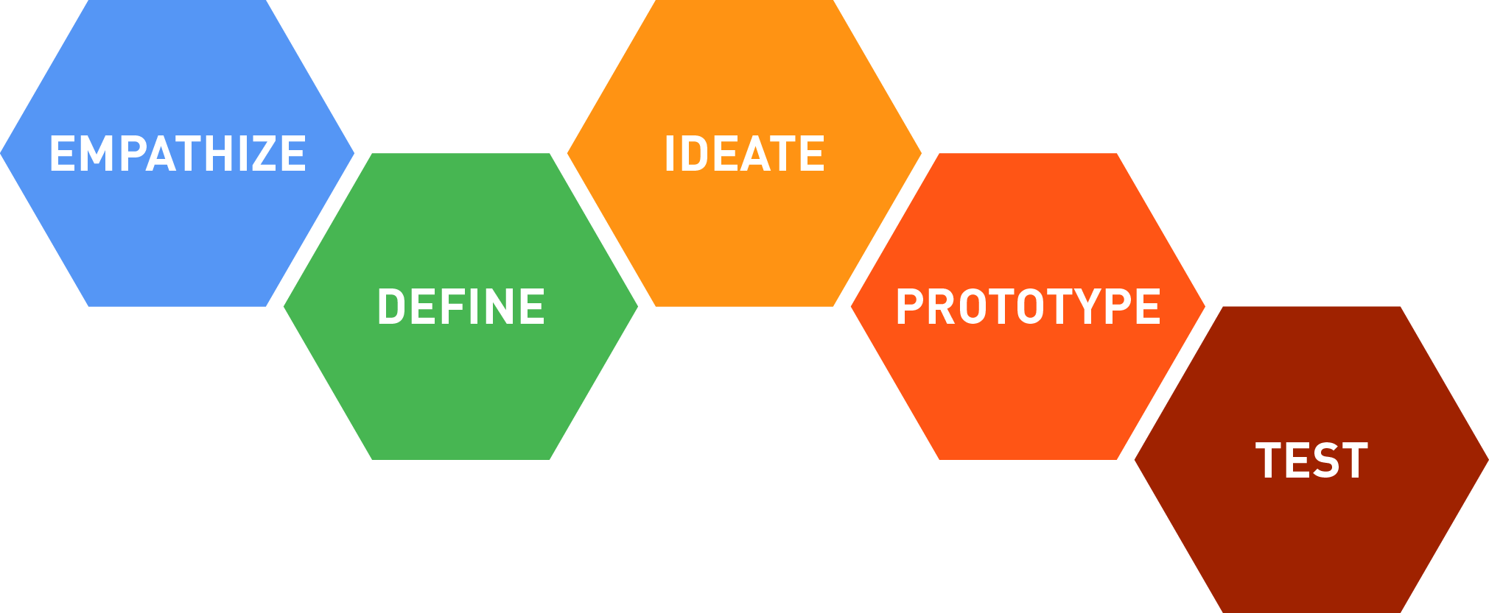
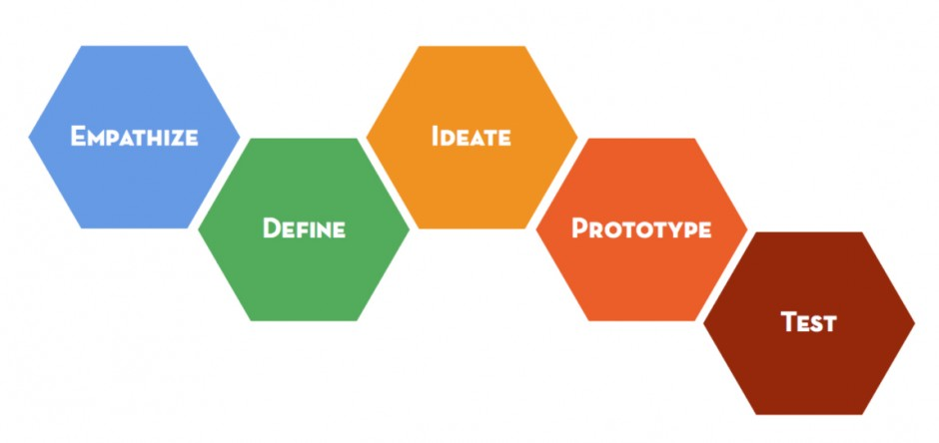
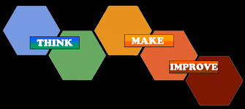

Design Thinking
Design Thinking Process
Notes:
Identify a need or a problem
Identify criteria & constraints
Brainstorm possible solutions
Generate Ideas
Explore possibilities
Select an Option
Build a model or a prototype
Test the design
Refine and iterate until a final design is chosen

Slide 4
Design Thinking
Why use the design thinking process?
Student engagement, and student-centered
STEAM opportunities --> various content areas blend naturally ex: music and math
Promotes growth mindsets

Slide 5
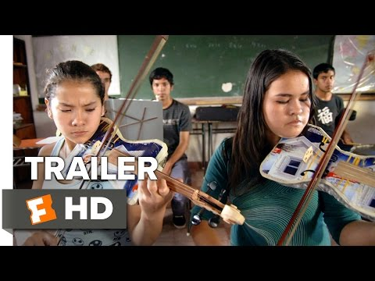
Design Thinking: Empathy
Empathize
Develop a deep understanding of the challenge
Identify a need or a problem to solve
Notes:
Empathize: develop a deep understanding of the challenge
Identify a need or a problem to solve.
Pipe music video

Slide 6
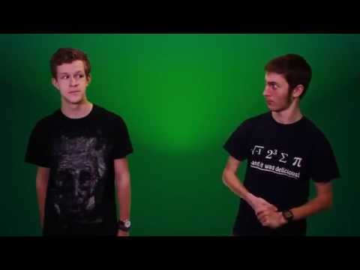
Design Thinking: Define
Define
Clearly articulate the problem you want to solve
Notes:
Define: clearly articulate the problem you want to solve
Identify criteria & constraints
Note key concepts that will be helpful in the design challenge
-pitch vs. note, -harmony, -vibrations

Slide 7

Design Thinking Activities
Ideate
Brainstorm potential solutions; select and develop your solution
Notes:
Ideate: Brainstorm potential solutions; select and develop your solution
-5 minute improv game to demonstrate ideation
Brainstorm possible solutions
Generate Ideas
Explore possibilities

Slide 8
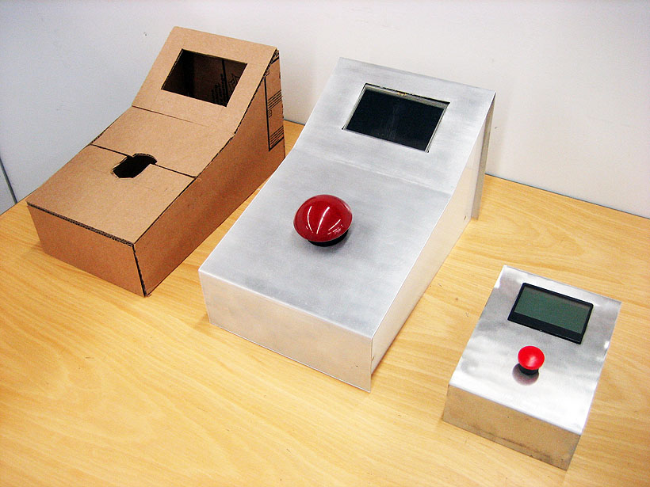
Design Thinking Activities
Prototype
Design a prototype (or series of prototypes) to test all or part of your solution.
Notes:
Prototype: Design a prototype (or series of prototypes) to test all or part of your solution.
Test: Engage in a continuous short-cycle innovation process to continually improve your design.
Select an Option
Build a model or a prototype
Test the design
Refine and iterate until a final design is chosen

Slide 9
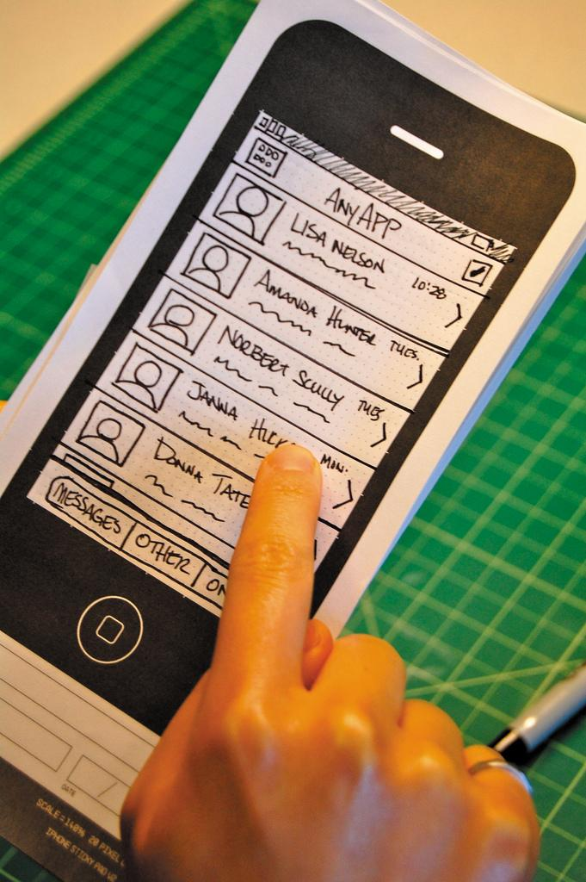
Design Thinking Activities
Test
Engage in a continuous short-cycle innovation process to continually improve your design.
Notes:
Select an Option
Build a model or a prototype
Test the design
Refine and iterate until a final design is chosen

Slide 10
Design Challenge: Make an Instrument
Things to Consider:
Active classroom management
Setup & cleanup
Materials
Notes:
Criteria - purpose of music (brainstorm as group to decide various purposes, such as soothing, or dance, or celebratory…)
Criteria
Constraints
Materials
Set up
management
30 min

Slide 11
Design Challenge: Make an Instrument
Criteria | Constraints
Your instrument must be able to play a simple song Your instrument must create 3 or more distinct pitches | Use at least 5 different materials provided Complete the challenge within 30 minutes.
Notes:
Criteria - purpose of music (brainstorm as group to decide various purposes, such as soothing, or dance, or celebratory…)
You must describe how your model works and how it connects to STEAM subjects

Slide 12
Design Challenge: Share Out Designs
Reflection
Opportunity for assessment
Pluses and deltas
Notes:
Criteria - purpose of music (brainstorm as group to decide various purposes, such as soothing, or dance, or celebratory…)

Slide 13
Going Further
Consider:
What standards can be addressed?
How can you continue or extend the design challenge?
How can you incorporate different content areas?
Notes:
Think-pair-share along ideas for going further
Other connections
Brainstorm possible define lessons
Ways to take activity further
Vary for ages/grades
Incorporating other subjects (history - fiction writing, scientific writing, science of instruments, world music tuning/history…)
20 min or remaining time

Slide 14
Going Further --- Standards
MATH --- CCSS.MATH.CONTENT.4.NF.B.3.D
Solve word problems involving addition and subtraction of fractions referring to the same whole and having like denominators, e.g., by using visual fraction models and equations to represent the problem.
CCSS.MATH.CONTENT.6.RP.A.3.D
Use ratio reasoning to convert measurement units; manipulate and transform units appropriately when multiplying or dividing quantities.
SCIENCE --- NGSS MS-PS4-2
Develop and use a model to describe that waves are reflected, absorbed, or transmitted through various materials.
VISUAL AND PERFORMING ARTS --- VAPA 5.0
Students apply what they learn in music across subject areas. They develop competencies and creative skills in problem solving, communication, and management of time and resources that contribute to lifelong learning and career skills. They learn about careers in and related to music.
ELA --- CCSS.ELA-LITERACY.CCRA.L.6
Acquire and use accurately a range of general academic and domain-specific words and phrases sufficient for reading, writing, speaking, and listening at the college and career readiness level; demonstrate independence in gathering vocabulary knowledge when encountering an unknown term important to comprehension or expression.
Notes:
Can you think of more standards? Other connections to science, technology, engineering, art, math, music, literacy, history, etc.?

Slide 15
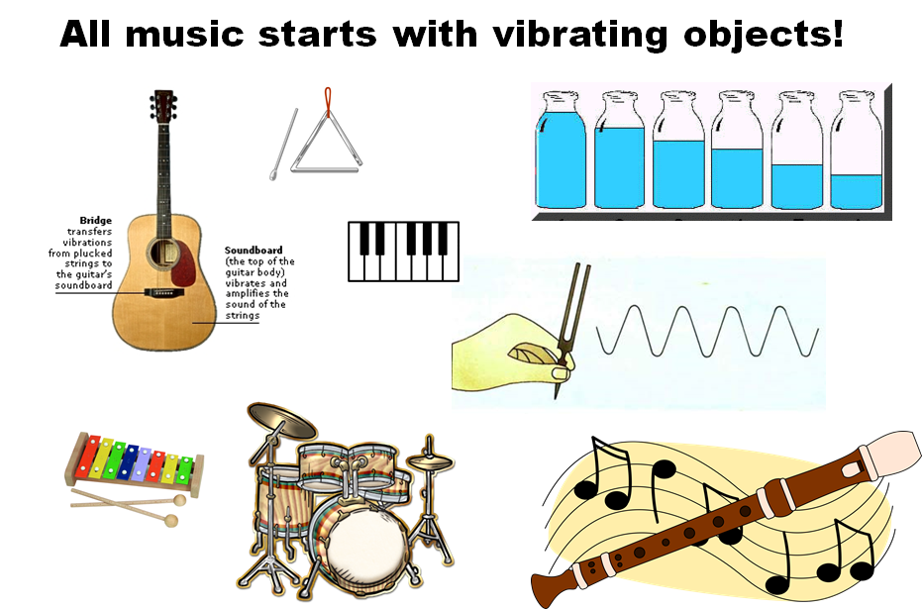
Going Further
Notes:
When an instrument is played, something is vibrating, which causes a wave of pressure changes that travels through the air and reaches your ear.
Math helps us understand the sounds produced by instruments.

Slide 16
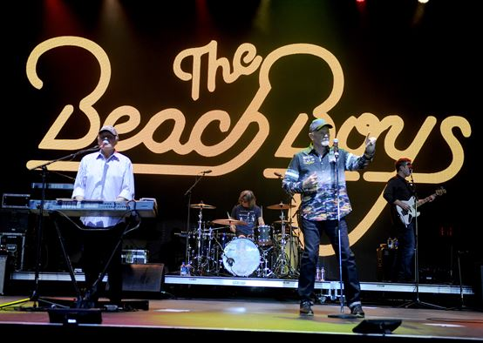

Going Further
Good vibrations!
Sound: a vibration that typically spreads as an audible wave of pressure, through a medium such as a gas, liquid, or a solid.
Notes:
Sounds are pressure waves. A 100 Hz note has a wavelength of about 3.4 meters.
The higher the frequency, the more times the waves are vibrating per second. For 440 Hz, the waves are vibrating 440 times per second.
Notice peaks at different heights form the spectrum of a note. On a violin, the spectrum shows shows the string vibrates at many different frequencies all at the same time (e.g., if play a note at 100 Hz, there are frequencies of 100, 200, 300, and so on…. the higher the frequency, the higher the pitch. The lowest frequency produced is called the “Fundamental”

Slide 17
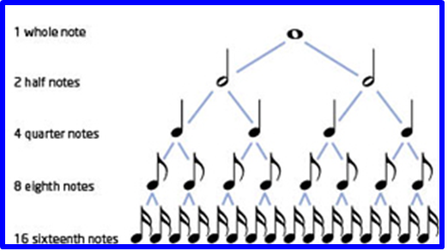
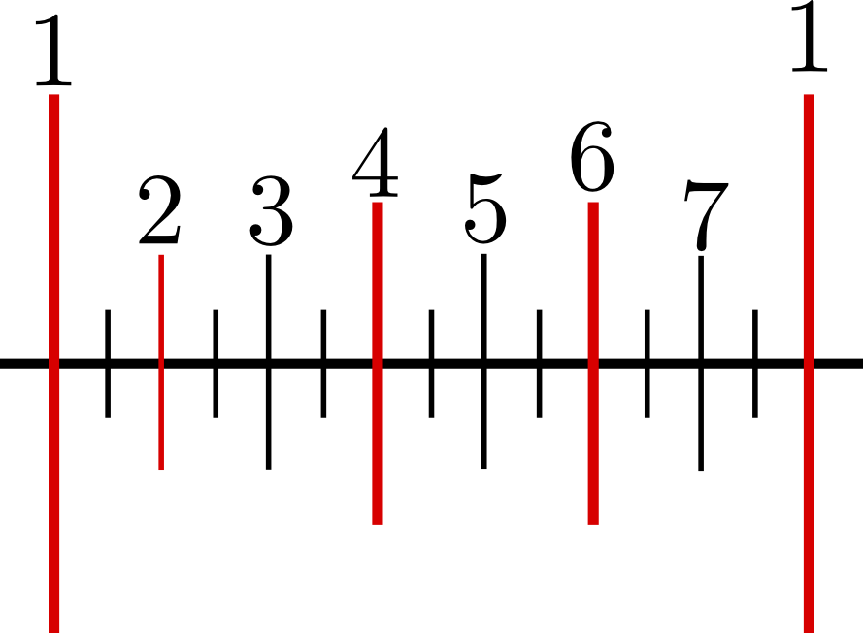
Going Further
Rhythm: the organization of notes based on time or their duration.
Notes:
Rhythm forms a fundamental component of all music. The math of rhythm is sometimes obvious (resembling a fraction), but it sometimes hides itself well (when a composer uses number theory to create a sense of instability in the music).

Slide 18
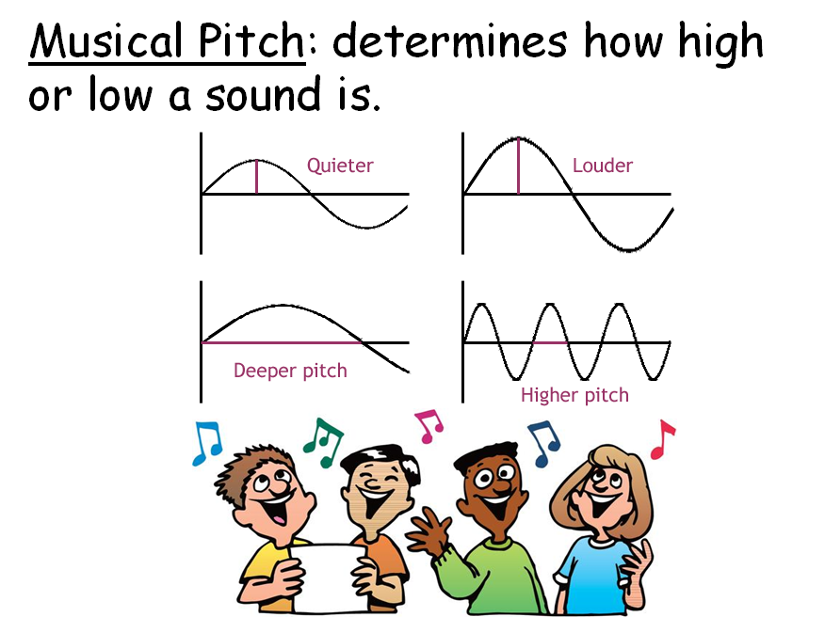
Going Further

Slide 19
